Slide 1
Operating system
Part I: Introduction
By KONG LingBo (孔令波)
Notes:
Before the class, I’d explain the use of the camera here. Don’t bother to consider your portrait risk ☺

Slide 2
Introduction
About me [孔令波, 76代]
Examination & Resources
Why should we learn this course?
Learning from classics is always the best way!
The simple view about OS: The repetition structure controlled by user’s choices

Slide 3
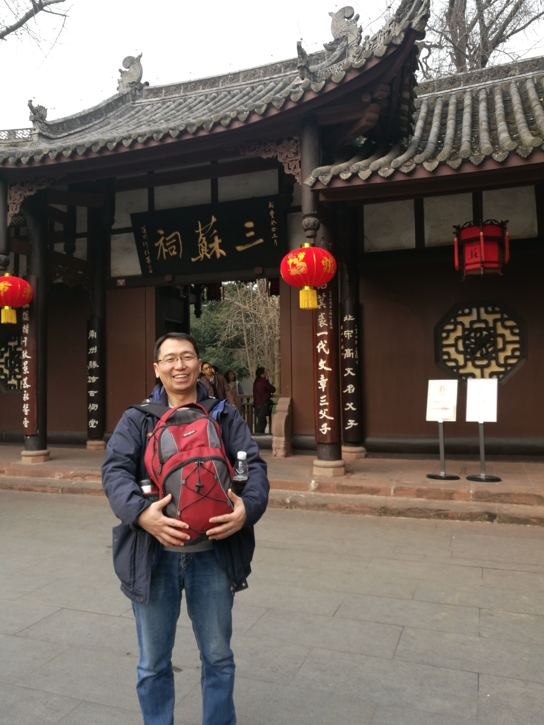
2017.1.23. SanSu Temple, MeiShan county
四川，眉山，三苏祠
Notes:
Following the convention in my class, I’ll share one picture during my winter holiday so that we can be familiar soon. This is taken in Cheng Du, Si Chuan Province.
“少不入川”

Slide 4
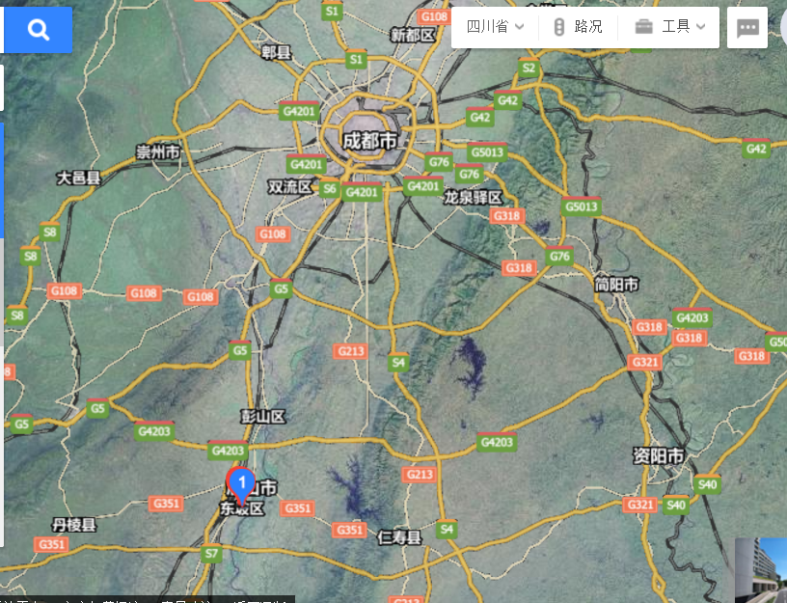

Slide 5

Contact me
You can find me here:
Yifu Building, West Wing 811
School of Software Engineering,
Beijing JiaoTong University (BJTU), Hai Dian District
Beijing 100044, China
Or email me:
mlinking@126.com
Our FTP:
ftp://202.205.101.184/ Usr & Psd: students
Tel:
15010255486

Slide 6
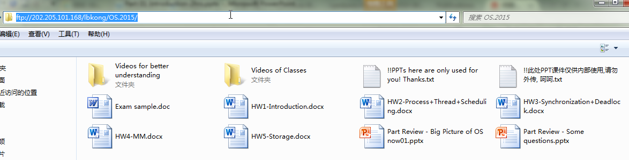
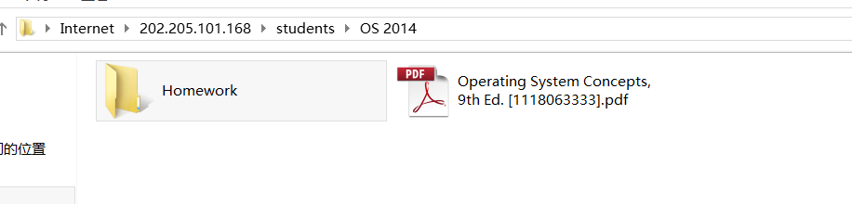
I hope you remember our FTP server!
ftp://202.205.101.168
students

Slide 7
Introduction
About me
Examination & Resources
Why should we learn this course?
Learning from classics is always the best way!
The simple view about OS: The repetition structure controlled by user’s choices

Slide 8
Reform!
This course contains two separate parts (credits too)
Lecture part ⬅ My responsibility
32 hours for 8 weeks from 1st (28 Feb) week to 8th week (18 April)
Two classes per week (both are at YF307)
Tue 16:20 ~ 18:10
Fri: 10:10 ~ 12:00
Training part ⬅ My responsibility
64 hours for 16 weeks from 1st week to 16th week (14 Jun)
One afternoon per week (at YF408)
Wed 14:10 ~ 18:10
3 checkpoints from OS (6 in total)
Process synchronization
Main Memory
IO + File
2 training projects

Slide 9
Examination for Lecture part
100 pts
Final exam (50)
2 hrs, close
Blank filling question, T/F, Multi-choice, Explanation, Short answer, Computation, Programming etc.
5 assignments (40)
5 Homeworks
Bonus (10)
5 random checks for your attendance
Notes:
研究生计分: 5个作业 (50), 4个项目 (40: framework, CPU scheduling, page replacement, disk scheduling), bonus (10) – 2012年8月5日10:48:22

Slide 10
How to earn the bonus?
Attend all the classes (5 random checks)
Help me to ameliorate this course
Good advices
To find some special pictures (Norman E. Gibbs)
To download the similar courses (in English) with better slides & materials (say why)
etc.

Slide 11
Examination for Training part
100 pts
Bonus (10)
5 chances
Basic checkpoints (40)
File + Index for large data management
Simulate multiple users
Try a Syntax parsing example
Debug HyperSQL
1 final Web-based application project (30)
Java/JSP+HyperSQL or C/C++ - R.D.I.P
Advanced checkpoints (40)
Understanding [transaction mechanism]/[SQL execution] in HyperSQL
More details later in practice part
Notes:
研究生计分: 5个作业 (50), 4个项目 (40: framework, CPU scheduling, page replacement, disk scheduling), bonus (10) – 2012年8月5日10:48:22
2017年2月28日01:32:47 [不提高的话, 最多80分; 提高的话, 超过100分则以100分计]
10 份考勤[随机的5次/16]
40 基本分[录像] – File+Index (非常大的数据), Simulate multiple users (threads with separate random 3 operations– read one record, update/increment/decrement, write back – 显示应该正确的结果和实际的结果), 编译器的例子(网上找一个类似SQL的, 调试通过), 调试 HSQL[1. 命令提示符加入BJTU的信息 - BJTU>> …(2); 2. SQL 输入但 echo (3 pts); 3. 得到一个简单的 Select SQL 的解析树结构 (5 pts)]
30 项目分[JSP+HSQL – web-based applications][可合作][按比重给分 – 比如一位学生贡献(得在报告里体现)/讲清楚了60%, 则得分 20*0.6=12] – 学生完成 R.D.I.P [R+D=10, I=10, P=10](学生信息管理系统, …, 或者 Android App 等)
40分提高[可合作] – Transaction 机制(锁机制的实现, MVCC机制) 和 SQL 的从翻译到执行(优化?)
尝试互助学习[Help-each-other style] – 你可以问你的同学, 甚至是得到他们的代码, 但是, 在视频中 (1) 必须从头敲代码; (2) 配的解说要说的通; (3) 最重要的是我会提问 ☺
R.D.I.P means Requirement analysis, Design, Implementation and Presentation.

Slide 12

HyperSQL
http://hsqldb.org/
http://www.hsqldb.org/web/hsqlPerformance.html
HyperSQL has multiple deployment and persistence options which influence its performance.
The table type, MEMORY, CACHED or TEXT, indicates how the table row data is stored and accessed by the database engine.
HyperSQL supports MVCC (Multi-Version Concurrency Control) and two phased locking transaction models.
HSQLDB is the only SQL open source database that supports a dedicated LOB (Large OBject) store .
…

Slide 13
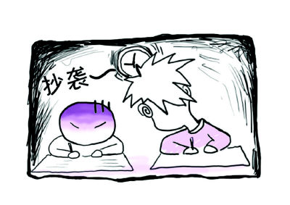
No Cheating!
Cheating
Even Failing is better than Cheating！

Slide 14
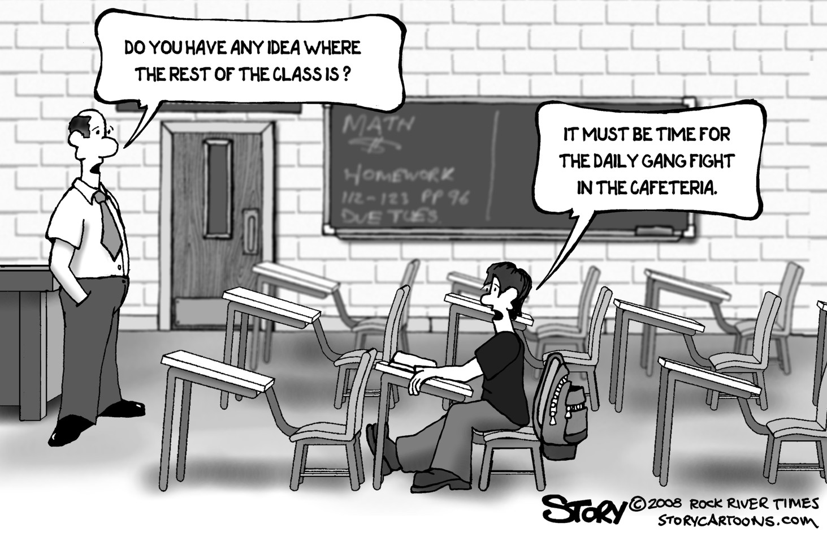
Your Responsibilities!
Attend all the classes!!!
http://giancarlomilanesi.fastpage.name/highschooltruancy/

Slide 15



Your Responsibilities!
Close your laptop if you could not answer my IN-CLASS questions
http://stay-away-from-internet-is-impossible-funny-cartoon.funnyfunny12.no-ip.org/?q=keep%20away%20from%20computer%20cartoon|||

Slide 16
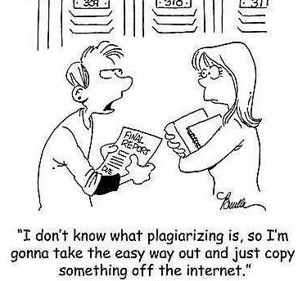

Your Responsibilities!
Hand in your assignments on time
Uphold academic honesty

Slide 17
Help Available
Me:
Come to my office (when necessary)
Always available by email, if I don’t reply in 24 hours, send again and complain ☺
Your classmates
Two heads are always better then one [三人行必有我师]
Web site & FTP server:
Most goes on the web, you should visit it often
ftp://202.205.101.168

Slide 18

To see or not to see me
We are not psychics
Please let us know if…
Class is too hard
You don’t have the background
Class can be improved in certain ways
……
When in doubt, email me …

Slide 19

If you behavior well, you could enjoy the study and life here ☺!

Slide 20
Introduction
About me
Examination & Resources
Why should we learn this course?
Learning from classics is always the best way!
The simple view about OS: The repetition structure controlled by user’s choices

Slide 21
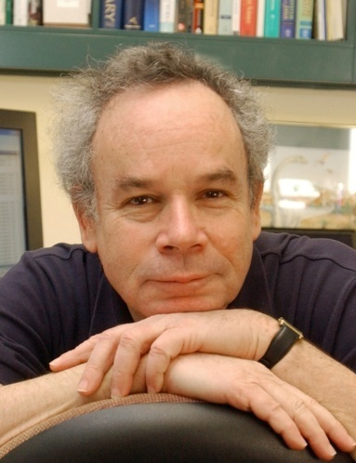
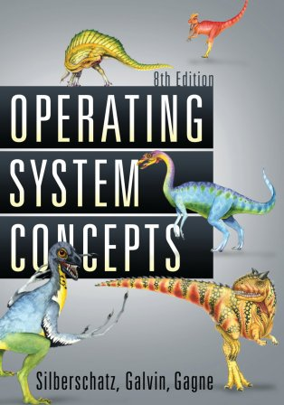
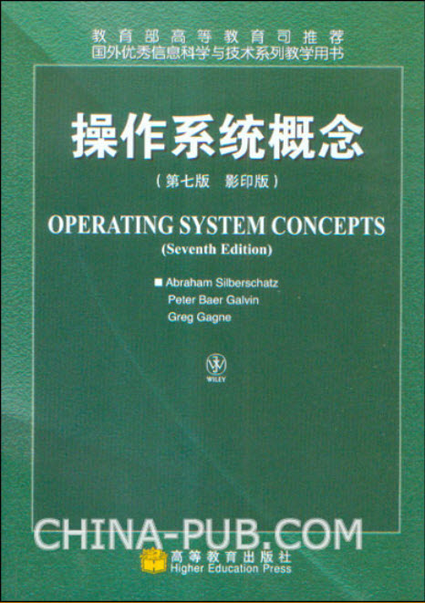

“OS Concepts” by Silberschatz, etc.
http://codex.cs.yale.edu/avi/db-book/db6/slide-dir/
http://codex.cs.yale.edu/avi/
A. Silberschatz, P. B. Galvin, and G. Gagne, “Operating Systems Concepts (with Java)”, 8th Edition, John Wiley & Sons, 2008.
http://cs-www.cs.yale.edu/homes/avi/os-book/index.html
Notes:
I also want to write a book on OS. I really hope that you guys could help me. You can ask me questions which I may not know yet. You can send me
-- [2012年8月5日11:13:08]

Slide 22
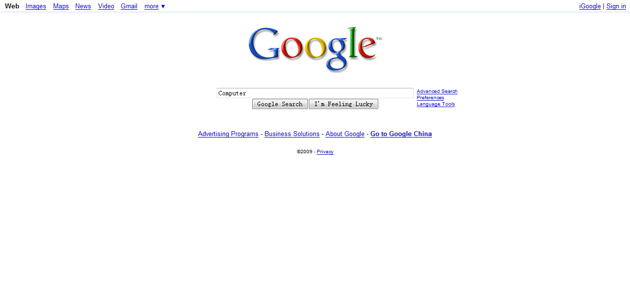
Web resources
Internet is always the source of rich information: Google
www.google.com, www.google.com.hk

Slide 23
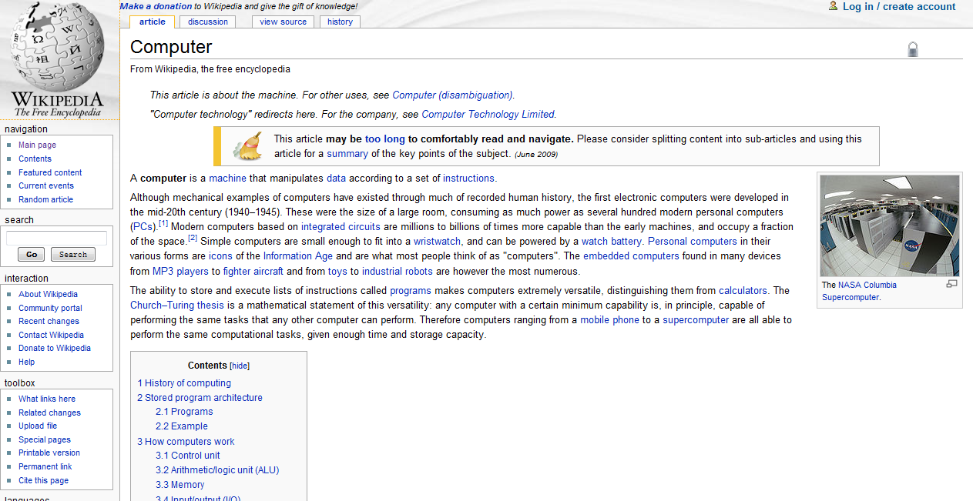
Web resources
Internet is always the source of rich information
http://en.wikipedia.org/wiki/Main_Page

Slide 24

Try to know the evil details to construct OS – have to control the devices!
Orange'S:一个操作系统的实现
作者: 于渊
出版社: 电子工业出版社
出版年: 2009-6
页数: 469
定价: 69.00元
装帧: 平装
ISBN: 9787121084423
Read it as you want
http://book.douban.com/subject/3735649/

Slide 25
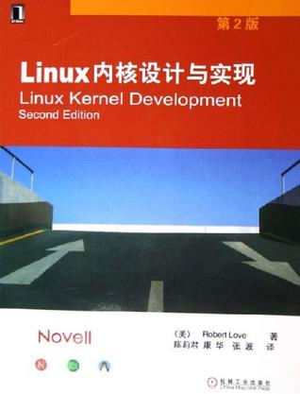
Linux内核设计与实现
作者: 拉芙
出版社: 机械工业
出版年: 2006-1
页数: 289
定价: 38.00元
ISBN: 9787111178651
Read it as you want
http://book.douban.com/subject/1503819/

Slide 26
Introduction
About me
Examination & Resources
Why should we learn this course?
Learning from classics is always the best way!
The simple view about OS: The repetition structure controlled by user’s choices

Slide 27
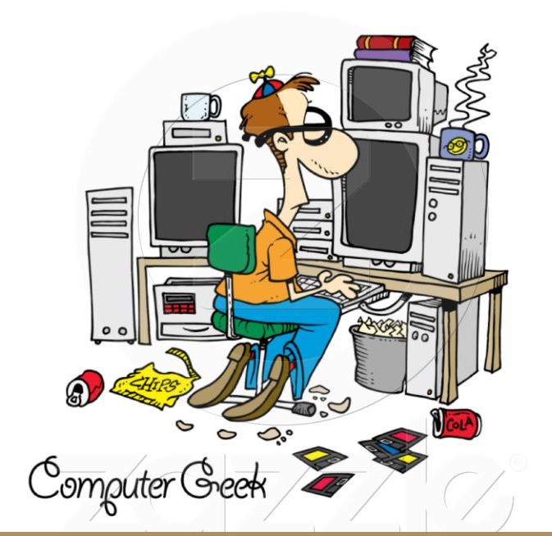


Do you know the top goals of this S.S.E for you?
你们知道我们对你们的期望吗?
Become more civilized!
Polite, enjoying nature, good habits, 。。。
computer geek: 计算机迷
Notes:
Sorry for the smoke fog (??)

Slide 28
Do you know the top goals of this S.S.E?
你们知道我们对你们的期望吗?
Showing you some life-making skills (Programming is one)!
Intern practice
- Try yourself in
companies
4th
Programming in IT companies
BI, SE, BA, Frontier topics, …
Widen your
ideas and skills
3rd
2nd
DSA, OS, DBMS, Web programming
Improving
Fundamental
programming
1st
Math, Programming (with C), OO (Java)
Notes:
By showing here, it means you have to learn and improve the skills by yourself! Never forget this!
Under the background like China, some students may think their responsibilities have been DONE once they entered universities.
Do you know the difference between “make a life / life making” and “make a living/ living making”?
“”

Slide 29
The understanding of the design and implementation of those classic softwares is helpful for us to improve our programming skills
OS is one!
Many problems we should consider carefully to cope with
Even you seems to have known many interesting facts
I’m a little ambitious to cover some concepts of those three classics in practice part

Slide 30
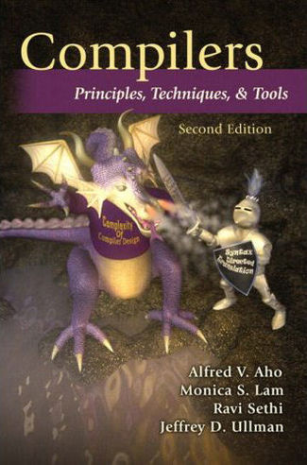
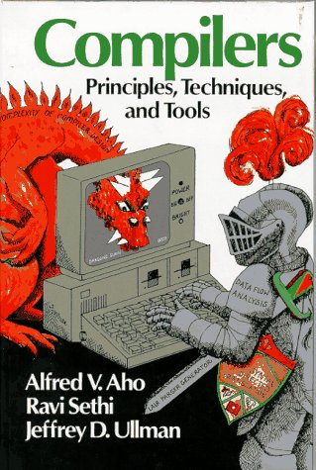
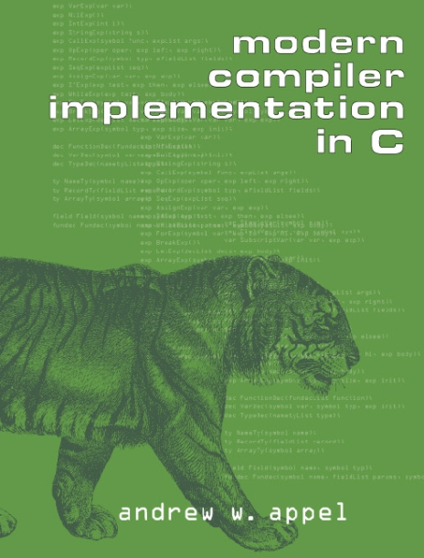
Learning from classics!
OS is one of the three classic softwares/programs for Computer Science
Compiler
Translator to convert source code into executable code
EXE is popular for Windows
a.out（assembler and link editor output 汇编器和链接编辑器的输出）、COFF（Common Object File Format 通用对象文件格式）、ELF（Executable and Linking Format 可执行和链接格式） for UNIX/LINUX
Notes:
Do you remember interpreter?? – the difference between compiler and interpreter?
Compiler theory is very complicated.

Slide 31

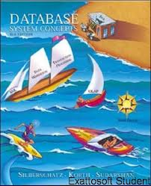
Learning from classics!
OS is one of the three classic softwares/programs for Computer Science
DBMS (Database Management System)
An important software to ease the management of the mass data for users
Notes:
Do you remember interpreter?? – the difference between compiler and interpreter?
Compiler theory is very complicated.

Slide 32
You’d be familiar with this
ALU
CPU
CU
Hardware
Memory
I/O
Computer
System
OS
Utilities
Drivers
…
System
software
Software
Document
Spreadsheet
Database Software
Graphics
…
Application
software
Notes:
The Von-Neumann architecture is an architecture for constructing actual computers (which implement what the Turing machine describes theoretically).

Slide 33
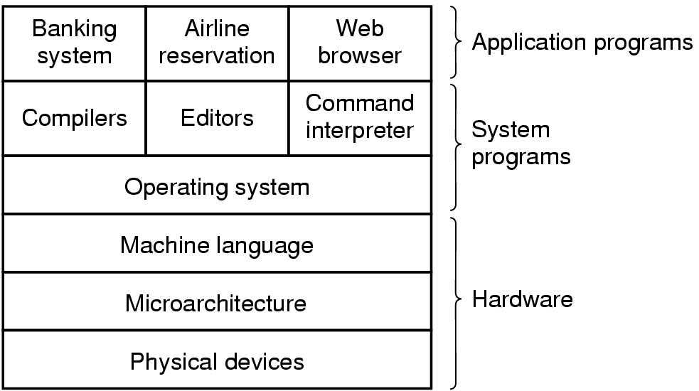
OS as an interface between Hardware and other softwares
You could do nothing with your computers
without OS

Slide 34
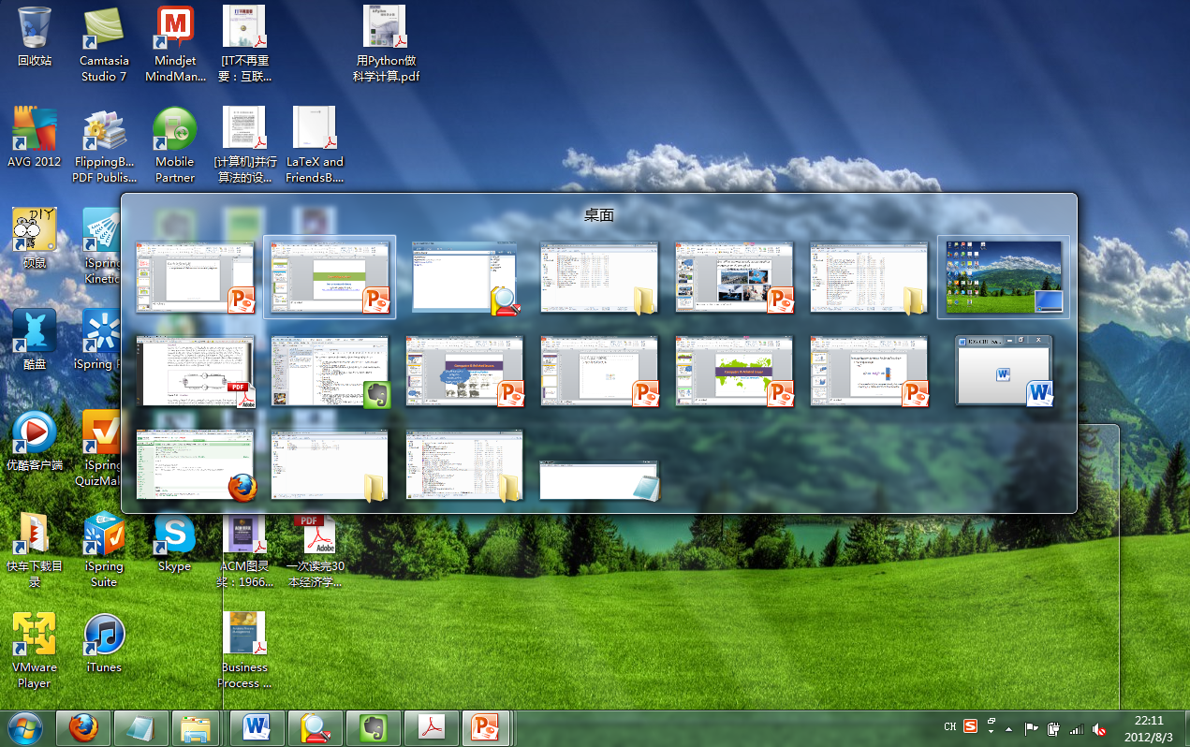
You may have known
The power of the modern computers is that you could execute your programs to process the data in it
Even with many programs

Slide 35
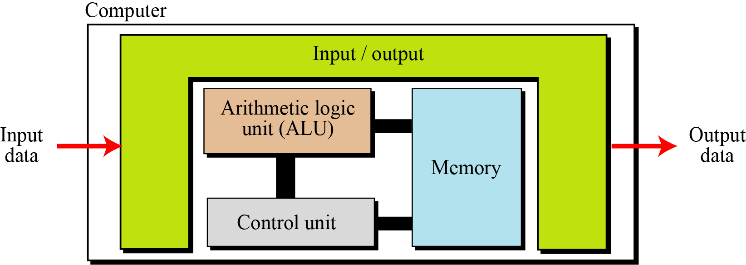
And you also have known
von Neumann architecture (1:1:M) is the basis of modern computers
1 CPU
1 addressed space
Many IO devices

Slide 36
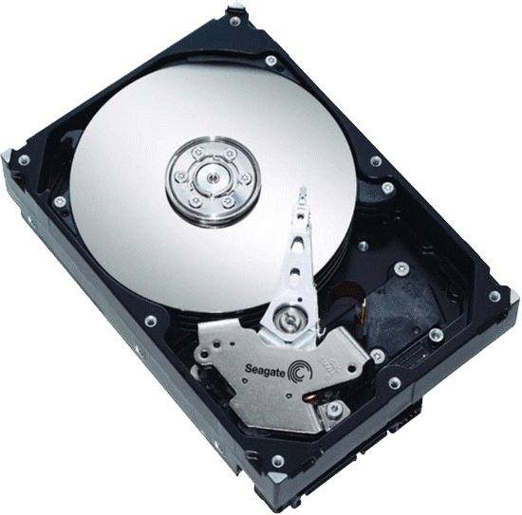
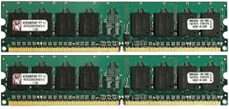
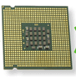
And many facts
A program exists first as FILE in Hard Disk (or CD, U-Disk etc.)
How to represent file (no matter your program or data – image, statistical data, audio, text, …) in the HD?
We should know the HD space and ? – sectors, tracks, …
Instructions and Data should be stored in Main Memory to run
We should know the used and available space of MM
How to allocate space for a program?
One CPU, One program
Put the starting instruction into corresponding registers
You’ve learned this in a course named like “Computer Organization”

Slide 37
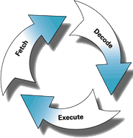
Situation of running a program
execute instructions serially in CPU
Programs are stored as Files in storage media
Program
X=1;
Y= 2;
Z= X+Y;
File
1
6C
2
6D
6E
Compiler
[编译器]
15
A0
6C
A1
16
A2
6D
A3
50
A4
Machine code
156C→0001010101101100
166D→0001011001101101
5056→0101000001010110
306E→0011000001101110
C000→1100000000000000
56
A5
30
A6
Put executable codes into the
memory of the computer
6E
A7
C0
A8
File
00
A9
Instructions are mapped into the address space of memory
Executable codes are also stored as Files in storage media

Slide 38
However, you may not know
How are those programs automatically carried out in a von Neumann computer (1:1:M)?
If you want to run a program, you just click an icon or a menu item.
How is this carried out?
The system software for this task is called OS (Operating System)
Also a collection of many programs

Slide 39
Short conclusion
Programming is the fundamental skill for CS/SE students
To learn the construction of the OS, one classic software, definitely is worth
Many complicated problems you should consider carefully to process
➔ This is the way to understand the theories, and improve your skills
No matter for math, physics, literature, astronomy, etc.

Slide 40
Introduction
About me
Examination & Resources
Why should we learn this course?
Learning from classics is always the best way!
The simple view about OS: The repetition structure controlled by user’s choices

Slide 41
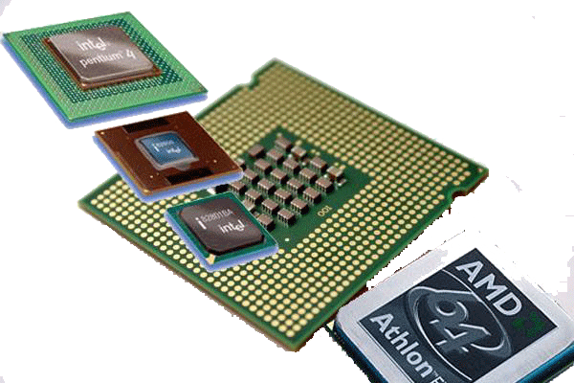
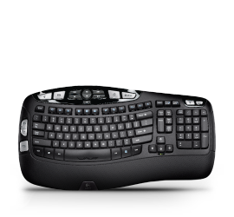
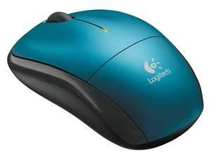
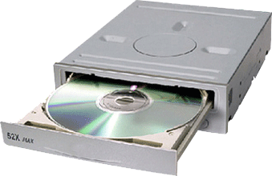
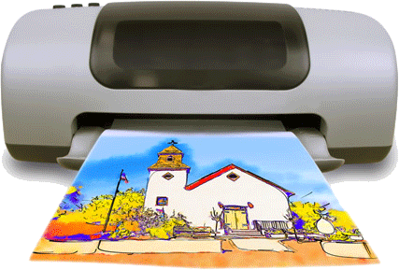
2 roles of OS
Efficient and safe manager for the resources [Resource Manager] to support the execution of concurrent programs
Storage media
I/O devices
Memory
CPU
Compiler Assembler Text editor … DBMS
System & application programs
Operating system
Computer hardware
Notes:
The hardware—the central processing unit (CPU), the memory, and the input/output (I/O) devices—provides the basic computing resources for the system.
The application programs—such as word processors, spreadsheets, compilers, and Web browsers—define the ways in which these resources are used to solve users’ computing problems.
The operating system controls the hardware and coordinates its use among the various application programs for the various users.

Slide 42
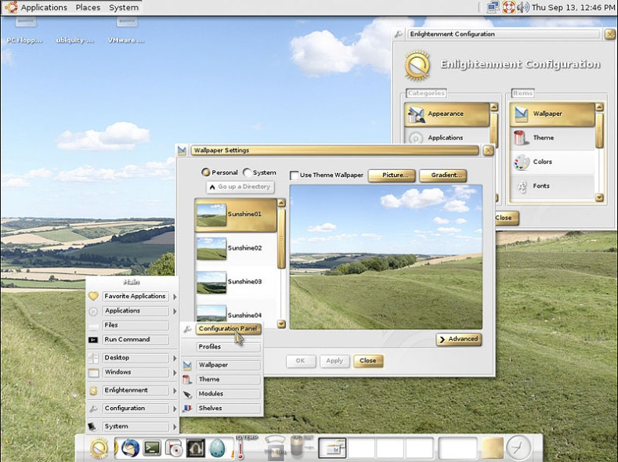
2 roles of OS
Friendly interface for the users
Files, GUI
User₁
User₂
User₃
User_{n}
W.I.M.P
Compiler Assembler Text editor … DBMS
System & application programs
Operating system
http://en.wikipedia.org/wiki/WIMP_%28computing%29
Computer hardware
Notes:
The hardware—the central processing unit (CPU), the memory, and the input/output (I/O) devices—provides the basic computing resources for the system.
The application programs—such as word processors, spreadsheets, compilers, and Web browsers—define the ways in which these resources are used to solve users’ computing problems.
The operating system controls the hardware and coordinates its use among the various application programs for the various users.

Slide 43
So the questions are
How to control devices through software?
Digital logic, Computer organization, …
How exactly is the OS constructed to support the execution of many concurrent programs?
We should analyze the problems the OS should consider first!
We’ll learn this in later chapters

Slide 44
A simple view for the OS
Flow chart:
The first understanding of OS is that
We could see OS as an REPETITION program structure
It seems
Start
Collect your input
Shutdown?
Yes
No
Do you want to
Run a program?
No
Do some
maintenance job
Yes
Prepare necessary
resource, and run
End

Slide 45
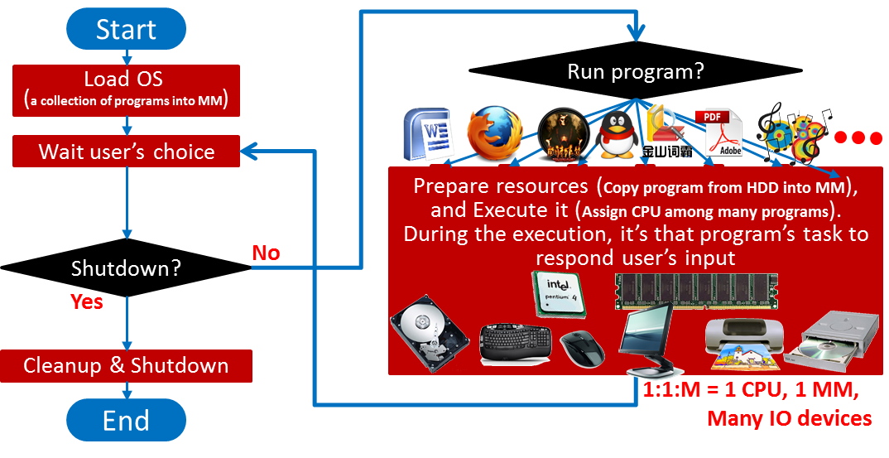
A more detailed diagram looks like as following
Notes:
However, that program could not directly communicate with user’s input at all – still based on the OS. OS acts as the “intermediator”.

Slide 46


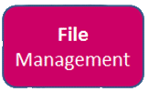
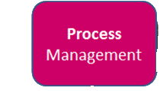
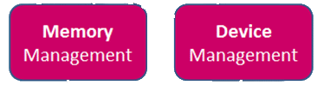

How do you think about the internal relationship of those programs in OS?
We have known the kernel resources of modern computers could be categorized into 4 kinds of resources / concepts
CPU, Main Memory, Hard Disk, File
Modern OS has 4 fundamental components
Notes:
[2014-02-26 21:27@西门之外]
According to the your experience of programming from those previous courses, I hope you could understand the skill to cope with the resources. That is, we construct corresponding modules for those resources – the libraries of functions. Therefore, we have three modules in modern OS: Process management module, Memory management module and Device management.

Slide 47
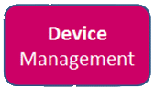
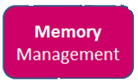
And according to the understanding of the execution of a program
Mapping 2: File → HDD
The OS should know first where your program is stored.
Then OS should copy the instructions and the data into MM
After the copy finishes, OS assigns CPU to your program to run
Mapping 1: File → MM
Execution – Scheduling CPU

Slide 48
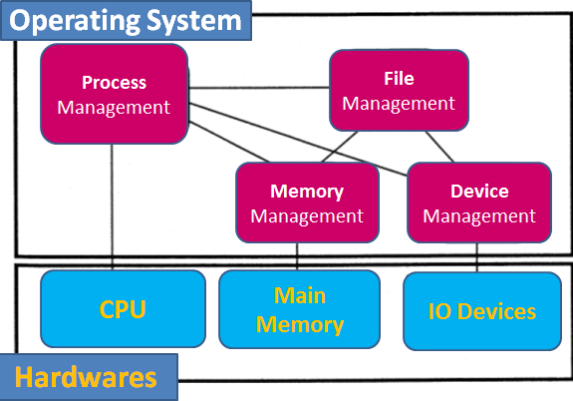
And we can infer the File concept is the hinge to combine them as a whole
Programs (including those of OS’s) exist as FILEs, which are stored in secondary storage media first, HDD, CD, etc.
The identification used to indicate the execution of a program is based on FILE concept
Copying programs into MM to run is also symbolized with FILE

Slide 49
OS is far complicated than those simple view
The core and hint to understand OS’s complexity is
How to support the concurrent execution of many programs with limited resources (von Neumann architecture)
The troubles leading to OS’s complexity are caused from this!
I hope you could remember this and really understand this to connect all the issues taught in this course together
We’ll talk about this more in next class

Slide 50
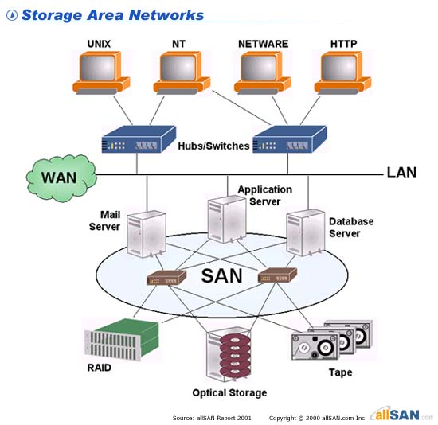
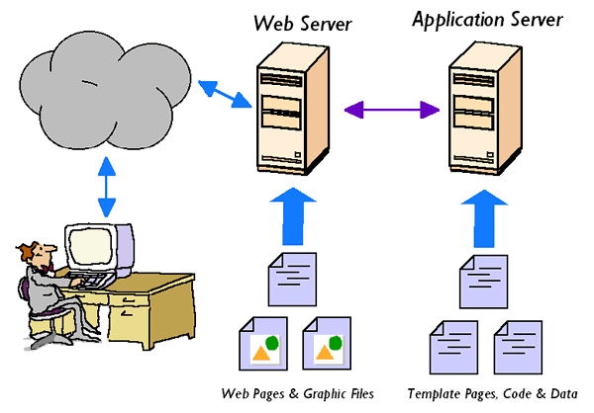
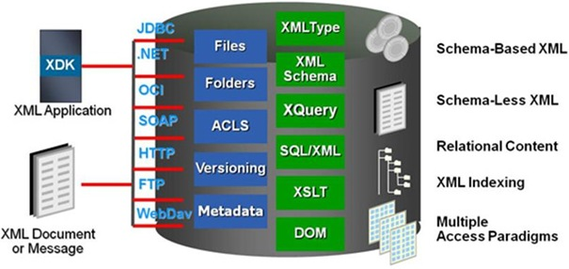
You can benefit from this course
Many advanced softwares are benefitting from the D&I of OS
There are many softwares/servers which are the basis of our IT age, such as DBMS, web server, FTP server, email server, SAN (Storage Area Network), Big Data (Hadoop + Spark), and all of them need support of OS
➔ System programming!

